Slide 1
Volunteer recruiting and succession planning
Paul Gruhn, P.E., CFSE, aeSolutions
2019 ISA President

Slide 2

Contents: What are we talking about?
Interactive discussion
Recruitment plan
Why people don’t volunteer
Volunteer interest
Volunteer retention
Succession planning
Training

Slide 3
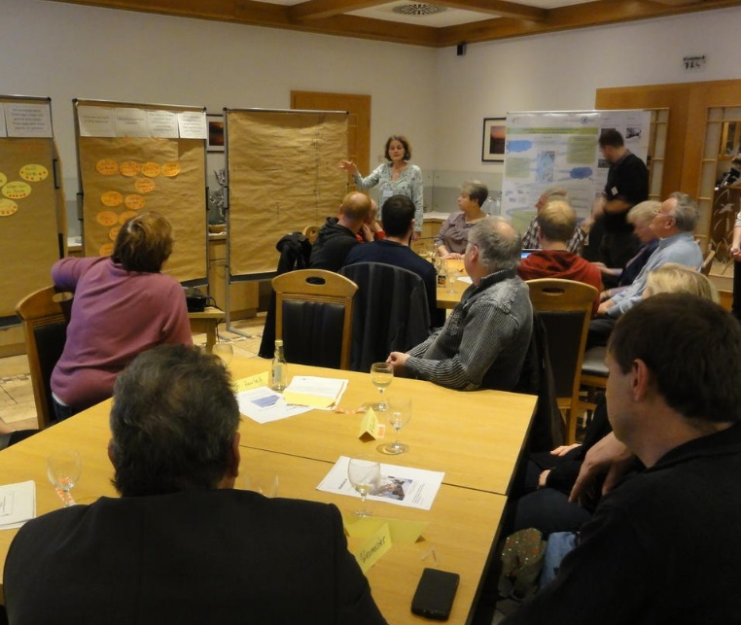
Interactive group discussion
When did you become a member, and why?
When did you become a volunteer, and why?
Please try and answer both questions within 1 minute
What – if anything – does it tell you when a leader has been in a position for 5+ years?
Notes:
I have found that people usually volunteer many years after they first become members. (They first join because they want to benefit from all the materials so they will be more effective in their job.) But most importantly, you will find two common themes; people volunteer for different reasons, and 90+ percent of people volunteer simply because someone asked them to. Therefore, the key takeaway for people to remember is to recruit one position at a time, determine who the best candidates are for that particular role, talk to one person at a time, and seek out the personal and professional benefits that that particular person will benefit from by serving (because it is different for everyone). Never do a general email or newsletter broadcast saying “we need volunteers”.
After you have done the above exercise, then you can go through the slides on recruiting. (Everyone will also benefit from reading the longer pdf file that is available on the ISA web site.)

Slide 4

Leadership development
Success without a successor is failure
  Keep your understudy posted on your plans and progress
  Assign responsibility gradually
  Delegate responsibility for specific tasks
  Have them give you frequent progress reports
  Hold them accountable
Notes:
A weakness with many I’ve observed.
Unless you develop the leadership potential within others, you’re destined to work too hard yourself! In your absence things will come to a virtual halt.
Until you develop a competent replacement, you may be cast in your current position indefinitely. (Is this what any of you want?!) This is an engraved invitation for burnout.
Cover the slide bullets.

Slide 5

Invite, don’t plead
“We need help” is a poor choice
Strike a balance
  Enough information to interest,
  but not too much to oversell
  Enough for people to self-screen themselves
  Be truthful and don’t play on guilt
You’re not asking for a favor, you’re offering an opportunity
Recruiting is like sowing seeds, there will be dry spells
Notes:
A common, but very poor, message for volunteer recruitment is, “We need help.” Everyone needs help!
How you present the invitation is very important. Strike a balance…
Cover rest of slide bullets.
At the recruitment stage, explain only the basics:
Introduce your organization as succinctly and clearly as possible. What do you do? Whom do you serve? What have been your successes?
Explain how volunteers contribute to the work of the organization. What have volunteers achieved in the past? What kinds of people volunteer?
Explain the work that needs to be done and why a volunteer is suited to do it. Go over the main elements of the job description.

Slide 6
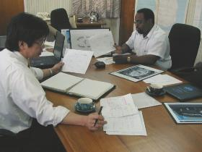
Recruitment plan
Four steps to develop and implement your plan:
  Brainstorm sources of people with the right qualifications for each position
  For each source, select the most appropriate means of communication
  Do it
  Develop a welcoming system
Avoid “we need volunteers” campaigns
Notes:
Cover the slide bullets.
1) Might be non-members!
4) Interviewing, screening, training, putting them to work.
Never conduct an industry or community-wide, cast-the-net, general, “we need volunteers” recruitment campaign. (As is so common.) Instead, do a series of min-campaigns focused on each volunteer assignment or on whatever special needs you have. The more you focus, the greater your chances of success.

Slide 7

Where to look for volunteers
There are no rules
Members or non-members
They may know what you do, but not that they could be involved, or that you need volunteers
Newsletters, e-mail, telephone, face-to-face, public speaking
Focus on one position at a time
Try and avoid the word “volunteer”
Notes:
Cover the slide bullets.
Avoid the word ‘volunteer’ (as it will interfere with getting your message across). Instead, use phrases like ‘get involved’, or ‘become a part of…’.
Have a title that grabs the reader’s attention. Do not imply that all candidates will be accepted. Instead, ask people to ‘apply’ or ‘call to talk about it’.
Be upbeat. No one jumps in to save a sinking ship. Stress what the volunteer will get as well as give.
One good example is, “Life is like a ten speed bike. Most of us have gears we never use. Subtitle: Find you missing gear – Volunteer.” (Even though that one violates the rule and uses the word ‘volunteer’!)
Toyota bait video.

Slide 8
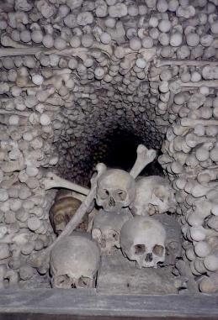
Why people don’t volunteer?
They don’t feel they were asked
  They may not realize they’re candidates
  They’re not saying “no”, they just don’t know you want them to say “yes”
If they’re saying “no”, you may have a problem to fix
Does your budget reflect your commitment?
Notes:
Publicity is not recruitment. Publicizing your needs in a newsletter may inform people of your needs, but people may not realize that they themselves are candidates. (Strange, but true.)
When people don’t want to join your effort, they may be telling you something about your organization. Fix the real problem and recruitment may take care of itself!
In order to recruit new volunteers, you have to ask.

Slide 9
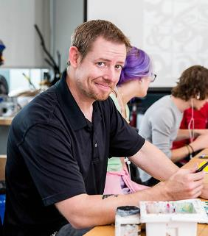
Volunteer interest
Reasons people remain committed:
  They feel appreciated
  They see they make a difference
  A chance for advancement
  Opportunity for growth
  Recognition
  A sense of belonging
  Recognition of the groups significance
  Their needs are being met
Notes:
The reasons why people remain on the job are often quite different from what grabbed them in the first place. Some reasons why people remain committed include:
Cover slide bullets.
Do any of these resonate with you? What keeps you involved?

Slide 10

Volunteer interest
Reasons people lose interest:
  Discrepancies between expectations and reality
  No praise, reward, or feeling of making a difference
  Routine assignments - no variety
  Lack of support
  Little prestige
  No growth
  Tension among co-workers
  Needs not being met
  No training
Notes:
Do any of these resonate with you? What has made you drop out of other organizations in the past?

Slide 11

Repetition
Recruiting is a continual process
Repetition is important
  Not everyone is available when you need them
  People change jobs and may not know of your needs
  It’s the same as advertising:
  3 contacts to make an impact
Sincerity wins out over technique

Slide 12
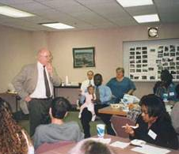
Training
Everyone needs training
  Not providing training…
  Your teenage kid and the car…
  Allow time to get to know one another
  Discuss your purpose & policies
  Explain committee structure and responsibilities
  Clarify goals and agree upon objectives
Notes:
Would you give your 16-year old your car keys and say, “Good luck! I hope you figure out how to be a good driver!”
Horse branding video. Learn to ride video.
New volunteers will make mistakes, but proper training will minimize there frequency and severity.
A board can’t work as a team if they don’t feel like a team. At least have an annual orientation program when new officers are elected.
Cover the slide bullets.
Also, develop budgets.
More details with next slide.

Slide 13
Training
Initial considerations:
  What’s your mission/purpose?
  What key result areas will you address?
  Establish goals, objectives and time frames
  How will progress be measured?
  Who has authority?
  Who will evaluate success,
  and when?

Slide 14

Board manual
A resource for understanding & clarification
Organization’s purpose statement
Constitution and bylaws
Organization’s goals and current plans
Annual report
Budget and financial report
Notes:
Distributed during orientation.

Slide 15
Board manual
A resource for understanding & clarification
Organization chart / roster (with names, addresses & phone numbers)
Committees
Personnel policies and expectations
Minutes from prior meetings
Lessons learned
Notes:
Distributed during orientation.

Slide 16
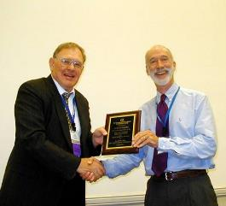
Volunteer retention
An outcome, not an activity
Ways to improve retention:
  Provide ongoing training
  Procedures for crediting volunteers
  Procedures for documenting the value of volunteers work
  Train paid staff on how to work with volunteers
  Make volunteering upwardly mobile
Notes:
Retention occurs when all the pieces are in place. It’s a result of having meaningful volunteer work, done by the right volunteer, in a welcoming environment.
Cover the slide bullets.

Slide 17

Volunteer retention
If retention is a problem, investigate:
  How realistic are job descriptions
  Working conditions
  Meaning or value of work
  Degree of difficulty of work
  Quality of training
  Did they feel appreciated
  Feedback they may have received on the quality of their work
  Differing expectations
Notes:
If things are not going well, you may need to consider (and possibly have exit interviews to check on):
Cover the slide bullets.

Slide 18



Some great references
Supervising Volunteers
An Action Guide for Making Your Job Easier
Lee & Catagnus
The Volunteer Recruitment (And Membership Development) Book
Ellis
Leadership Skills
Developing Volunteers for Organizational Success
Morrison
Notes:
For the full details…

Slide 19
And more…
Developing ISA leaders for organizational success
Part 1: The Basics: https://youtu.be/RuuA5BgtRGo
Part 2: Recruiting: https://youtu.be/dydiLN0lfhc
Part 3: Details: https://youtu.be/L7qoJKaj3Kk
https://www.isa.org/members-corner/leader-resources/operating-documents/
(Last item on the page: "Developing ISA Volunteers for Organizational Success")

Slide 20
What we covered
Interactive discussion
Recruitment plan
Why people don’t volunteer
Volunteer interest
Volunteer retention
Succession planning
Training

Slide 21

Open discussion
Your successes…
Your failures…
Your lessons learned…

